Slide 1
WELDING

Slide 2
WELDING PROCESSES
Arc Welding
Resistance Welding
Oxyfuel Gas Welding
Other Fusion Welding Processes
Solid State Welding
Weld Quality
Weldability
Design Considerations in Welding

Slide 3
Two Categories of Welding Processes
Fusion welding - coalescence is accomplished by melting the two parts to be joined, in some cases adding filler metal to the joint
  Examples: arc welding, resistance spot welding, oxyfuel gas welding
Solid state welding - heat and/or pressure are used to achieve coalescence, but no melting of base metals occurs and no filler metal is added
  Examples: forge welding, diffusion welding, friction welding

Slide 4
Arc Welding
A fusion welding process in which coalescence of the metals is achieved by the heat from an electric arc between an electrode and the work
Electric energy from the arc produces temperatures ~ 10,000 F (5500 C), hot enough to melt any metal
Most AW processes add filler metal to increase volume and strength of weld joint

Slide 5
What is an Electric Arc?
An electric arc is a discharge of electric current across a gap in a circuit
It is sustained by an ionized column of gas (plasma) through which the current flows
To initiate the arc in AW, electrode is brought into contact with work and then quickly separated from it by a short distance

Slide 6
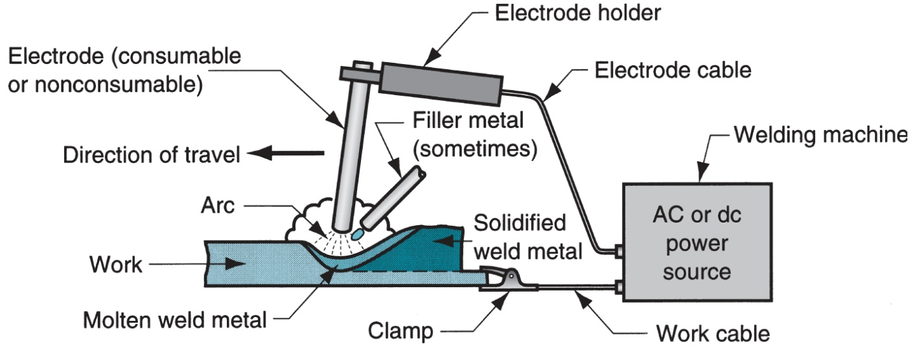
Arc Welding
A pool of molten metal is formed near electrode tip, and as electrode is moved along joint, molten weld pool solidifies in its wake

Slide 7
Manual Arc Welding and Arc Time
Problems with manual welding:
  Weld joint quality
  Productivity
Arc Time = (time arc is on) divided by (hours worked)
  Also called “arc-on time”
  Manual welding arc time = 20%
  Machine welding arc time ~ 50%

Slide 8
Consumable Electrodes
Forms of consumable electrodes
  Welding rods (a.k.a. sticks) are 9 to 18 inches and 3/8 inch or less in diameter and must be changed frequently
  Weld wire can be continuously fed from spools with long lengths of wire, avoiding frequent interruptions
In both rod and wire forms, electrode is consumed by the arc and added to weld joint as filler metal

Slide 9
Non consumable Electrodes
Made of tungsten which resists melting
Gradually depleted during welding (vaporization is principal mechanism)
Any filler metal must be supplied by a separate wire fed into weld pool

Slide 10
Arc Shielding
At high temperatures in AW, metals are chemically reactive to oxygen, nitrogen, and hydrogen in air
  Mechanical properties of joint can be degraded by these reactions
  To protect operation, arc must be shielded from surrounding air in AW processes
Arc shielding is accomplished by:
  Shielding gases, e.g., argon, helium, CO₂
  Flux

Slide 11
Flux
A substance that prevents formation of oxides and other contaminants in welding, or dissolves them and facilitates removal
Provides protective atmosphere for welding
Stabilizes arc
Reduces spattering

Slide 12
Various Flux Application Methods
Pouring granular flux onto welding operation
Stick electrode coated with flux material that melts during welding to cover operation
Tubular electrodes in which flux is contained in the core and released as electrode is consumed

Slide 13
Power Source in Arc Welding
Direct current (DC) vs. Alternating current (AC)
  AC machines less expensive to purchase and operate, but generally restricted to ferrous metals
  DC equipment can be used on all metals and is generally noted for better arc control

Slide 14
Consumable Electrode
AW Processes
Shielded Metal Arc Welding
Gas Metal Arc Welding
Flux‑Cored Arc Welding
Electrogas Welding
Submerged Arc Welding

Slide 15
Shielded Metal Arc Welding (SMAW)
Uses a consumable electrode consisting of a filler metal rod coated with chemicals that provide flux and shielding
Sometimes called "stick welding"
Power supply, connecting cables, and electrode holder available for a few thousand dollars

Slide 16
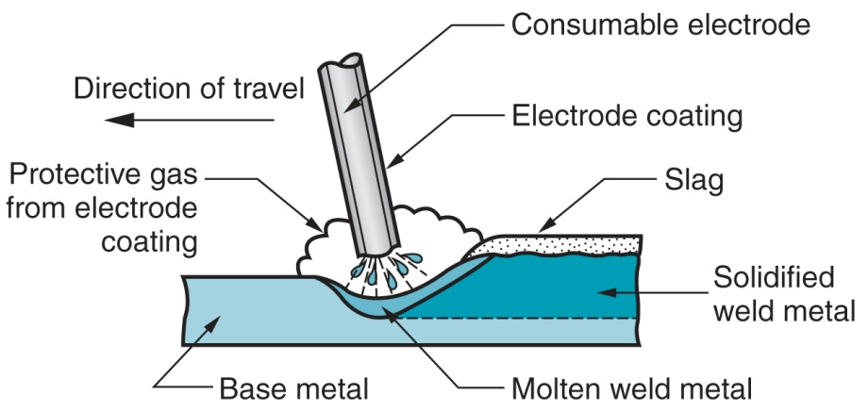
Shielded Metal Arc Welding (SMAW)

Slide 17
Welding Stick in SMAW
Composition of filler metal usually close to base metal
Coating: powdered cellulose mixed with oxides and carbonates, and held together by a silicate binder
Welding stick is clamped in electrode holder connected to power source
Disadvantages of stick welding:
  Sticks must be periodically changed
  High current levels may melt coating prematurely

Slide 18
SMAW Applications
Used for steels, stainless steels, cast irons, and certain nonferrous alloys
Not used or rarely used for aluminum and its alloys, copper alloys, and titanium

Slide 19
Gas Metal Arc Welding (GMAW)
Uses a consumable bare metal wire as electrode with shielding by flooding arc with a gas
Wire is fed continuously and automatically from a spool through the welding gun
Shielding gases include argon and helium for aluminum welding, and CO₂ for steel welding
Bare electrode wire plus shielding gases eliminate slag on weld bead
  No need for manual grinding and cleaning of slag

Slide 20
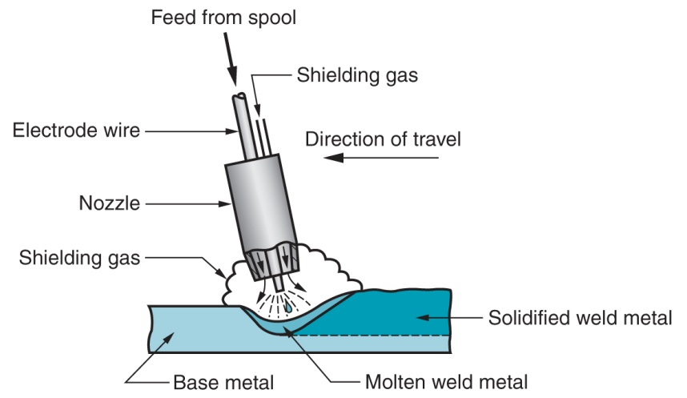
Gas Metal Arc Welding (GMAW)

Slide 21
GMAW Advantages over SMAW
Better arc time because of continuous wire electrode
  Sticks must be periodically changed in SMAW
Better use of electrode filler metal than SMAW
  End of stick cannot be used in SMAW
Higher deposition rates
Eliminates problem of slag removal
Can be readily automated

Slide 22
Flux‑Cored Arc Welding (FCAW
Adaptation of shielded metal arc welding, to overcome limitations of stick electrodes - two versions
  Self‑shielded FCAW - core includes compounds that produce shielding gases
  Gas‑shielded FCAW - uses externally applied shielding gases
Electrode is a continuous consumable tubing (in coils) containing flux and other ingredients (e.g., alloying elements) in its core

Slide 23
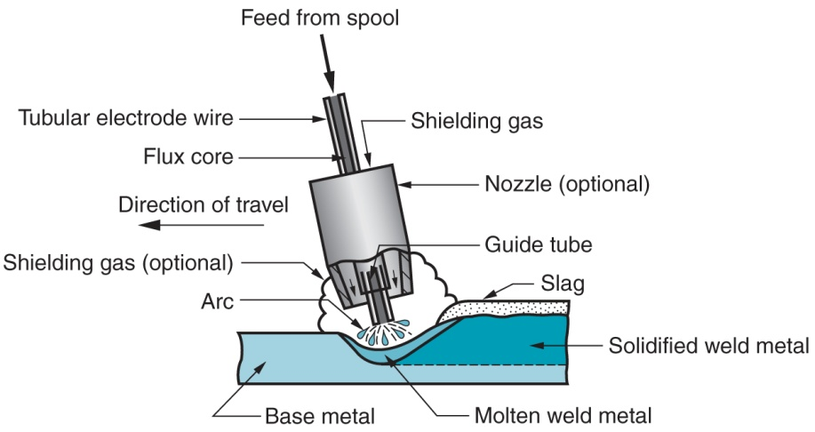
Flux‑Cored Arc Welding (FCAW
Presence or absence of externally supplied shielding gas distinguishes: (1) self‑shielded - core provides ingredients for shielding, (2) gas‑shielded - uses external shielding gases

Slide 24
Electrogas Welding (EGW)
Uses a continuous consumable electrode, flux‑cored wire or bare wire with externally supplied shielding gases, and molding shoes to contain molten metal
When flux‑cored electrode wire is used and no external gases are supplied, then special case of self‑shielded FCAW
When a bare electrode wire used with shielding gases from external source, then special case of GMAW

Slide 25
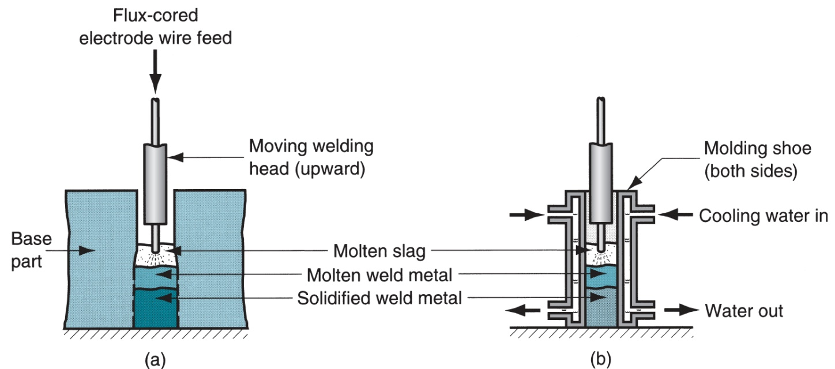
Electrogas Welding (EGW)
Electrogas welding using flux‑cored electrode wire: (a) front view with molding shoe removed for clarity, and (b) side view showing molding shoes on both sides

Slide 26
Submerged Arc Welding (SAW)
Uses a continuous, consumable bare wire electrode, with arc shielding by a cover of granular flux
Electrode wire is fed automatically from a coil
Flux introduced into joint slightly ahead of arc by gravity from a hopper
  Completely submerges operation, preventing sparks, spatter, and radiation

Slide 27
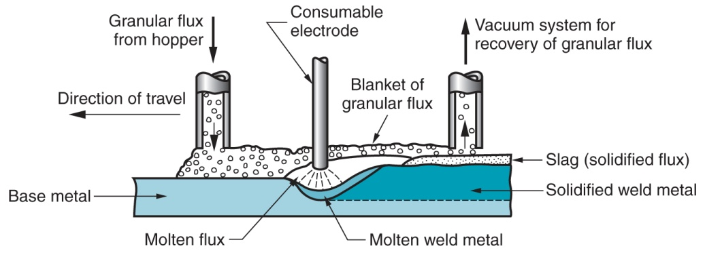
Submerged Arc Welding (SAW)

Slide 28
SAW Applications and Products
Steel fabrication of structural shapes (e.g., I‑beams)
Seams for large diameter pipes, tanks, and pressure vessels
Welded components for heavy machinery
Most steels (except hi C steel)
Not good for nonferrous metals

Slide 29
Nonconsumable Electrode Processes
Gas Tungsten Arc Welding
Plasma Arc Welding
Carbon Arc Welding
Stud Welding

Slide 30
Gas Tungsten Arc Welding (GTAW)
Uses a nonconsumable tungsten electrode and an inert gas for arc shielding
Melting point of tungsten = 3410°C (6170°F)
A.k.a. Tungsten Inert Gas (TIG) welding
  In Europe, called "WIG welding"
Used with or without a filler metal
  When filler metal used, it is added to weld pool from separate rod or wire
Applications: aluminum and stainless steel mostly

Slide 31
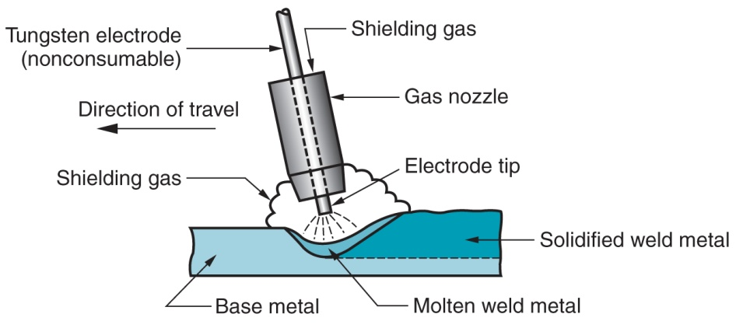
Gas Tungsten Arc Welding (GTAW)

Slide 32
Advantages and Disadvantages of GTAW
Advantages:
High quality welds for suitable applications
No spatter because no filler metal through arc
Little or no post-weld cleaning because no flux
Disadvantages:
Generally slower and more costly than consumable electrode AW processes

Slide 33
Plasma Arc Welding (PAW)
Special form of GTAW in which a constricted plasma arc is directed at weld area
Tungsten electrode is contained in a nozzle that focuses a high velocity stream of inert gas (argon) into arc region to form a high velocity, intensely hot plasma arc stream
Temperatures in PAW reach 28,000°C (50,000°F), due to constriction of arc, producing a plasma jet of small diameter and very high energy density

Slide 34
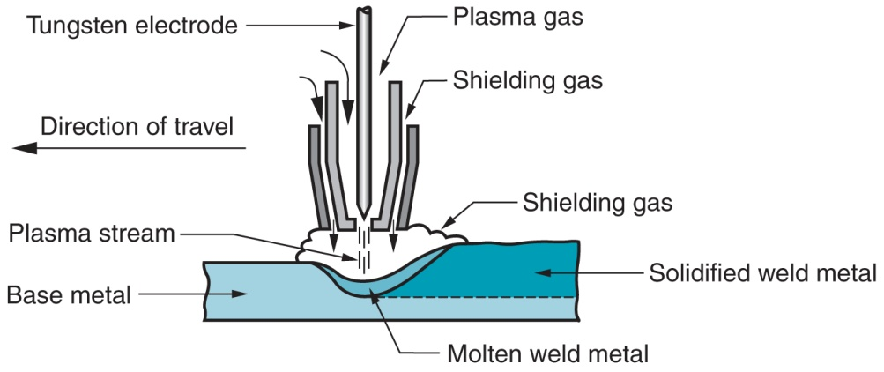
Plasma Arc Welding (PAW)

Slide 35
Advantages and Disadvantages of PAW
Advantages:
Good arc stability and excellent weld quality
Better penetration control than other AW processes
High travel speeds
Can be used to weld almost any metals
Disadvantages:
High equipment cost
Larger torch size than other AW processes
  Tends to restrict access in some joints

Slide 36
Resistance Welding
A group of fusion welding processes that use a combination of heat and pressure to accomplish coalescence
Heat generated by electrical resistance to current flow at junction to be welded
Principal RW process is resistance spot welding (RSW)

Slide 37
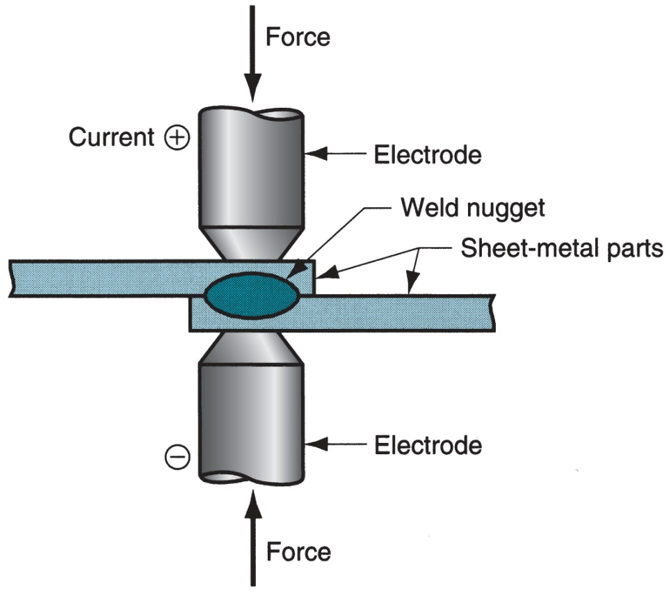
Resistance Welding
Resistance welding, showing components in spot welding, the main process in the RW group

Slide 38
Components in Resistance Spot Welding
Parts to be welded (usually sheet metal)
Two opposing electrodes
Means of applying pressure to squeeze parts between electrodes
Power supply from which a controlled current can be applied for a specified time duration

Slide 39
Advantages and Drawbacks of Resistance Welding
Advantages:
No filler metal required
High production rates possible
Lends itself to mechanization and automation
Lower operator skill level than for arc welding
Good repeatability and reliability
Disadvantages:
High initial equipment cost
Limited to lap joints for most RW processes

Slide 40
Resistance Spot Welding (RSW)
Resistance welding process in which fusion of faying surfaces of a lap joint is achieved at one location by opposing electrodes
Used to join sheet metal parts
Widely used in mass production of automobiles, metal furniture, appliances, and other sheet metal products
  Typical car body has ~ 10,000 spot welds
  Annual production of automobiles in the world is measured in tens of millions of units

Slide 41
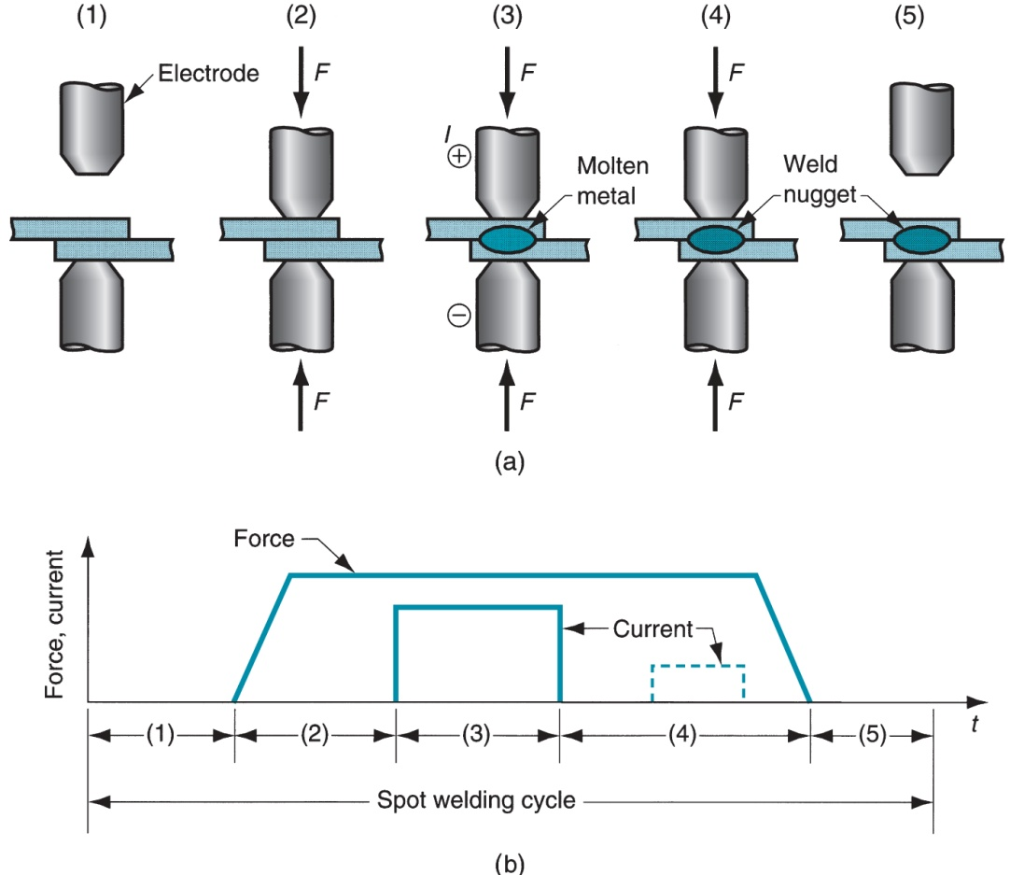
Spot Welding Cycle
(a) Spot welding cycle
(b) Plot of force and current
Cycle: (1) parts inserted between electrodes,
(2) electrodes close,
(3) current on,
(4) current off,
(5) electrodes opened

Slide 42
Resistance Seam Welding (RSEW)
Uses rotating wheel electrodes to produce a series of overlapping spot welds along lap joint
Can produce air‑tight joints
Applications:
  Gasoline tanks
  Automobile mufflers
  Various sheet metal containers

Slide 43
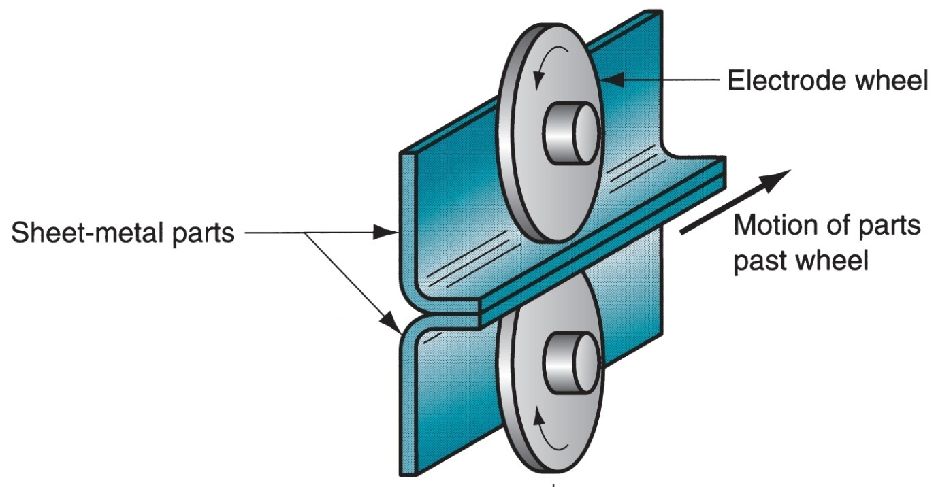
Resistance Seam Welding (RSEW)

Slide 44
Resistance Projection Welding (RPW)
A resistance welding process in which coalescence occurs at one or more small contact points on the parts
Contact points determined by design of parts to be joined
  May consist of projections, embossments, or localized intersections of parts

Slide 45
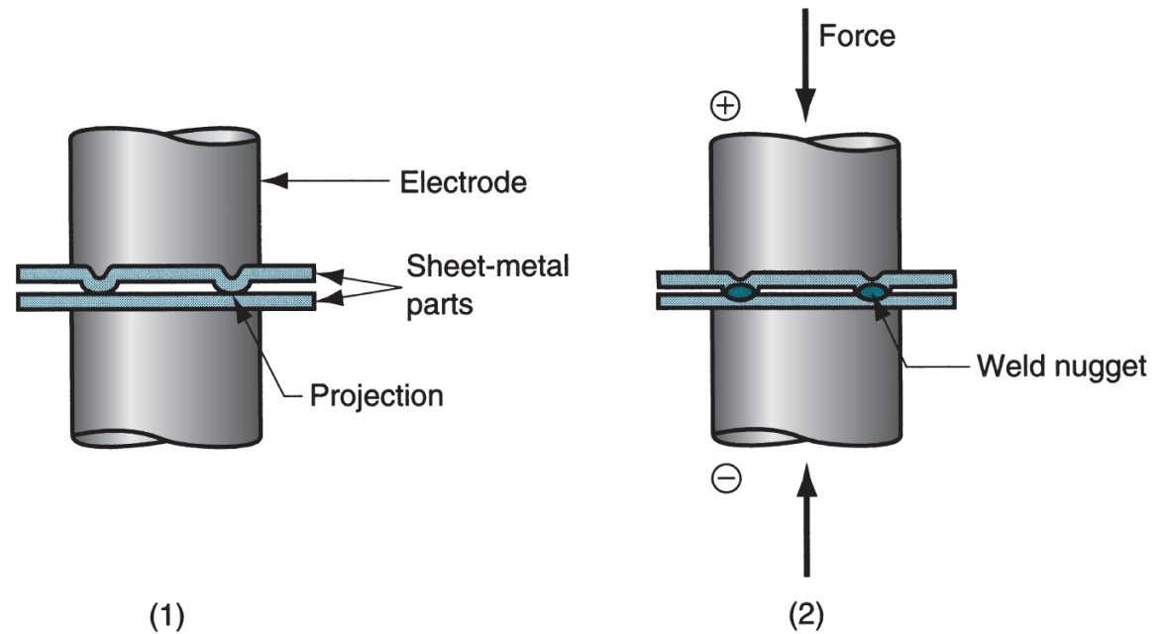
Resistance Projection Welding (RPW)
(1) Start of operation, contact between parts is at projections; (2) when current is applied, weld nuggets similar to spot welding are formed at the projections

Slide 46
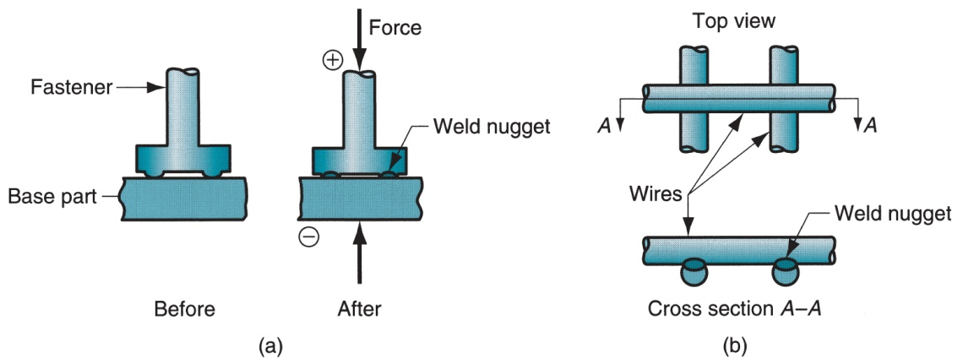
Other Resistance Projection Welding Operations
(a) Welding of fastener on sheetmetal and (b) cross-wire welding

Slide 47
Oxyfuel Gas Welding (OFW)
Group of fusion welding operations that burn various fuels mixed with oxygen
OFW employs several types of gases, which is the primary distinction among the members of this group
Oxyfuel gas is also used in flame cutting torches to cut and separate metal plates and other parts
Most important OFW process is oxyacetylene welding

Slide 48
Oxyacetylene Welding (OAW)
Fusion welding performed by a high temperature flame from combustion of acetylene and oxygen
Flame is directed by a welding torch
Filler metal is sometimes added
  Composition must be similar to base metal
  Filler rod often coated with flux to clean surfaces and prevent oxidation

Slide 49
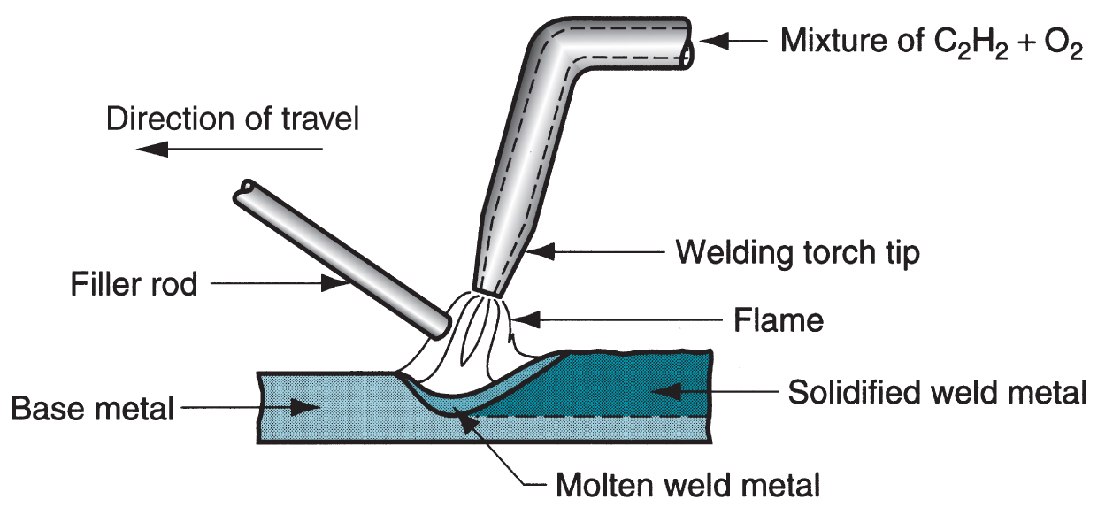
Oxyacetylene Welding

Slide 50
Acetylene (C₂H₂)
Most popular fuel among OFW group because it is capable of higher temperatures than any other
  Up to 3480°C (6300°F)
Two stage reaction of acetylene and oxygen:
  First stage reaction (inner cone of flame)
    C₂H₂ + O₂ → 2CO + H₂ + heat
  Second stage reaction (outer envelope)
    2CO + H₂ + 1.5O₂ → 2CO₂ + H₂O + heat

Slide 51
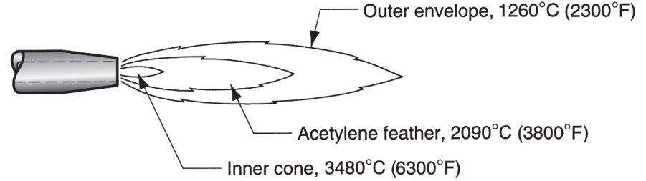
Oxyacetylene Torch
Maximum temperature reached at tip of inner cone, while outer envelope spreads out and shields work surface from atmosphere
Shown below is neutral flame of oxyacetylene torch indicating temperatures achieved

Slide 52
Safety Issue in OAW
Together, acetylene and oxygen are highly flammable
C₂H₂ is colorless and odorless
  It is therefore processed to have characteristic garlic odor

Slide 53
OAW Safety Issue
C₂H₂ is physically unstable at pressures much above 15 lb/in² (about 1 atm)
  Storage cylinders are packed with porous filler material saturated with acetone (CH₃COCH₃)
  Acetone dissolves about 25 times its own volume of acetylene
Different screw threads are standard on C₂H₂ and O₂ cylinders and hoses to avoid accidental connection of wrong gases

Slide 54
Alternative Gases for OFW
Methylacetylene‑Propadiene (MAPP)
Hydrogen
Propylene
Propane
Natural Gas

Slide 55
Other Fusion Welding Processes
FW processes that cannot be classified as arc, resistance, or oxyfuel welding
Use unique technologies to develop heat for melting
Applications are typically unique
Processes include:
  Electron beam welding
  Laser beam welding
  Electroslag welding
  Thermit welding

Slide 56
Electron Beam Welding (EBW)
Fusion welding process in which heat for welding is provided by a highly‑focused, high‑intensity stream of electrons striking work surface
Electron beam gun operates at:
  High voltage (e.g., 10 to 150 kV typical) to accelerate electrons
  Beam currents are low (measured in milliamps)
Power in EBW not exceptional, but power density is

Slide 57
EBW Vacuum Chamber
When first developed, EBW had to be carried out in a vacuum chamber to minimize disruption of electron beam by air molecules
  Serious inconvenience in production
    Pumpdown time can take as long as an hour

Slide 58
Three Vacuum Levels in EBW
High-vacuum welding – welding in same vacuum chamber as beam generation to produce highest quality weld
Medium-vacuum welding – welding in separate chamber but partial vacuum reduces pump-down time
Non-vacuum welding – welding done at or near atmospheric pressure, with work positioned close to electron beam generator - requires vacuum divider to separate work from beam generator

Slide 59
EBW Advantages and Disadvantages of EBW
Advantages:
High‑quality welds, deep and narrow profiles
Limited heat affected zone, low thermal distortion
No flux or shielding gases needed
Disadvantages:
High equipment cost
Precise joint preparation & alignment required
Vacuum chamber required
Safety concern: EBW generates x‑rays

Slide 60
Laser Beam Welding (LBW)
Fusion welding process in which coalescence is achieved by energy of a highly concentrated, coherent light beam focused on joint
LBW normally performed with shielding gases to prevent oxidation
Filler metal not usually added
High power density in small area
  So LBW often used for small parts

Slide 61
Comparison: LBW vs. EBW
No vacuum chamber required for LBW
No x‑rays emitted in LBW
Laser beams can be focused and directed by optical lenses and mirrors
LBW not capable of the deep welds and high depth‑to‑width ratios of EBW
  Maximum LBW depth = ~ 19 mm (3/4 in), whereas EBW depths = 50 mm (2 in)

Slide 62
Thermit Welding (TW)
FW process in which heat for coalescence is produced by superheated molten metal from the chemical reaction of thermite
Thermite = mixture of Al and Fe₃O₄ fine powders that produce an exothermic reaction when ignited
Also used for incendiary bombs
Filler metal obtained from liquid metal
Process used for joining, but has more in common with casting than welding

Slide 63
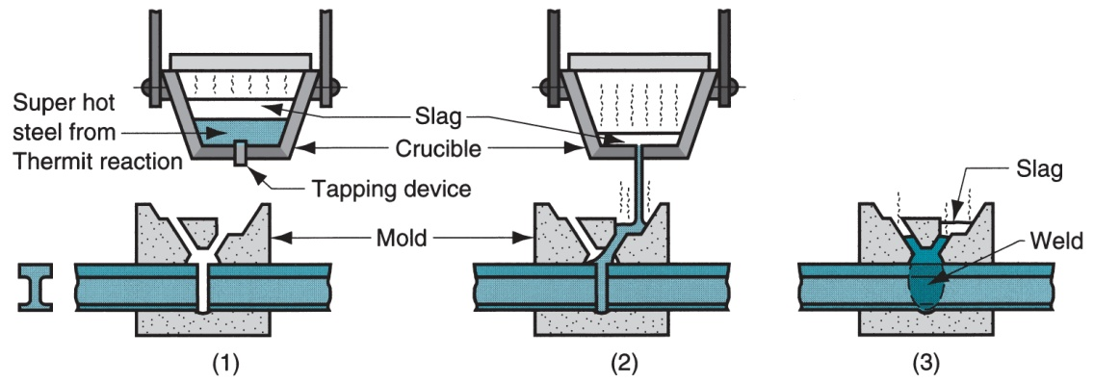
Thermit Welding (TW)
Thermit ignited; (2) crucible tapped, superheated metal flows into mold;
(3) metal solidifies to produce weld joint

Slide 64
TW Applications
Joining of railroad rails
Repair of cracks in large steel castings and forgings
Weld surface is often smooth enough that no finishing is required

Slide 65
Solid State Welding (SSW)
Coalescence of part surfaces is achieved by:
  Pressure alone, or
  Heat and pressure
    If both heat and pressure are used, heat is not enough to melt work surfaces
  For some SSW processes, time is also a factor
No filler metal is added
Each SSW process has its own way of creating a bond at the faying surfaces

Slide 66
Success Factors in SSW
Essential factors for a successful solid state weld are that the two faying surfaces must be:
  Very clean
  In very close physical contact with each other to permit atomic bonding

Slide 67
SSW Advantages over FW Processes
If no melting, then no heat affected zone, so metal around joint retains original properties
Many SSW processes produce welded joints that bond the entire contact interface between two parts rather than at distinct spots or seams
Some SSW processes can be used to bond dissimilar metals, without concerns about relative melting points, thermal expansions, and other problems that arise in FW

